Slide 3
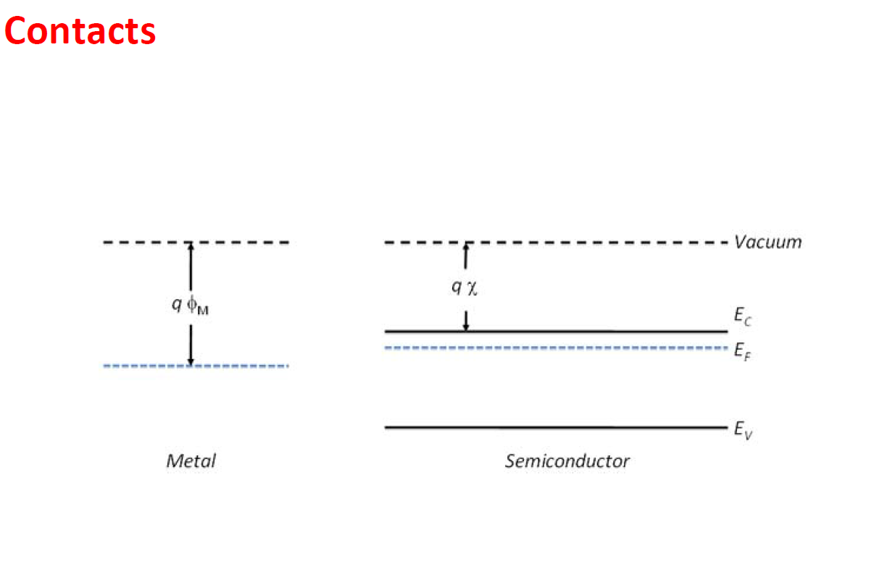

Slide 4
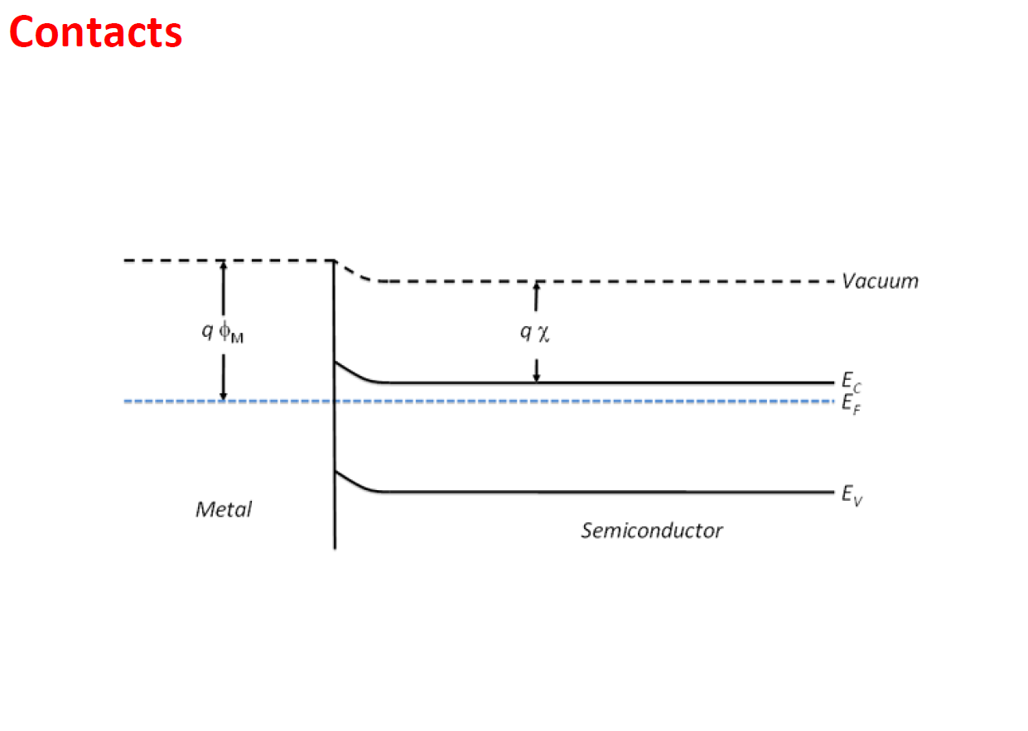

Slide 5
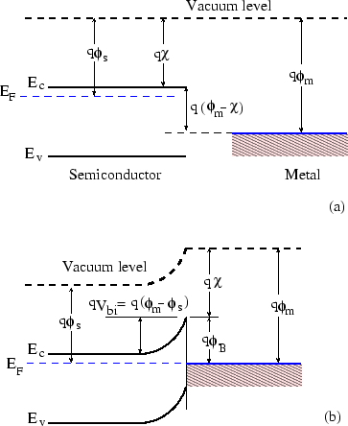

Slide 7
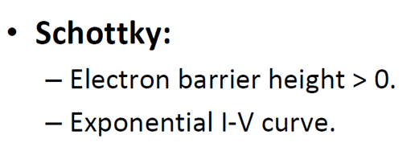
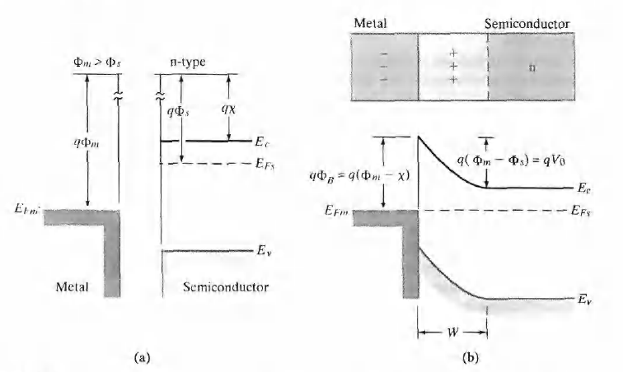
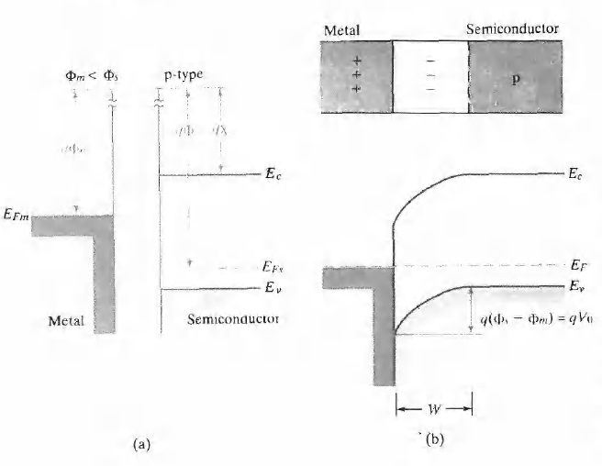

Slide 8
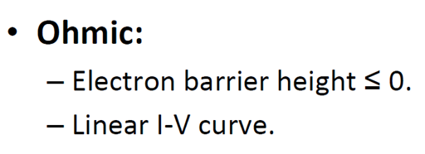
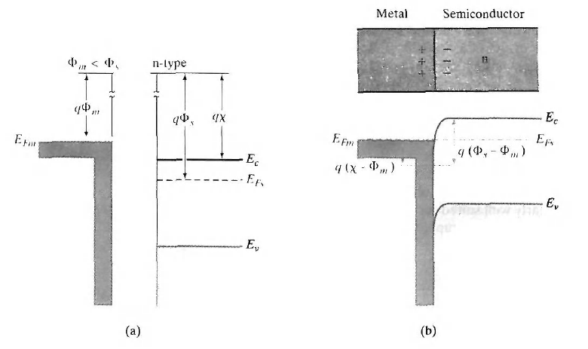
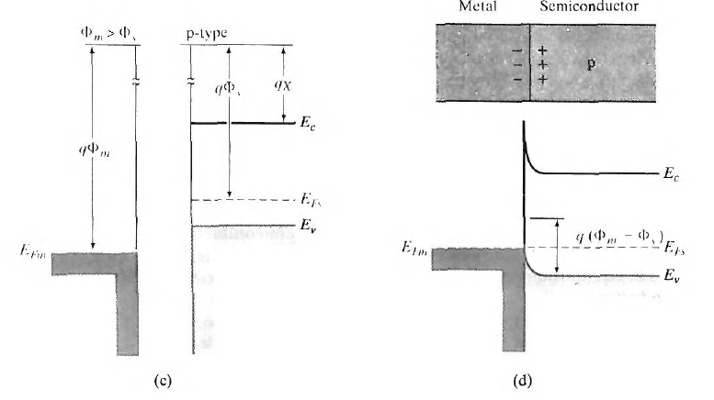

Slide 9
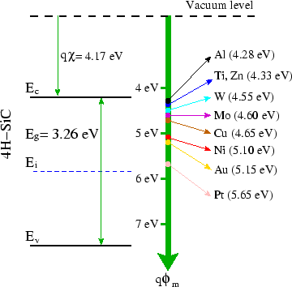

Slide 10
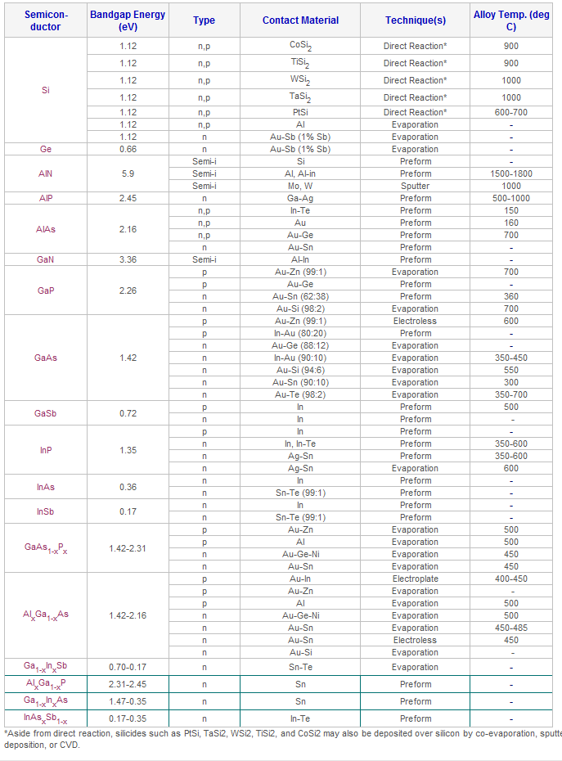
http://www.siliconfareast.com/ohmic_table.htm

Slide 15
Thermal equilibrium (Boltzmann Dist.)
Photogeneration
Carrier-carrier collisions (uniform dist. of excess energy)
Energy loss by phonon emission (high energy optical and acoustic phonons)
5), 6) Recombination of electron-hole pairs
7), 8) Loss of excess energy and relaxation to equilibrium states

Slide 16
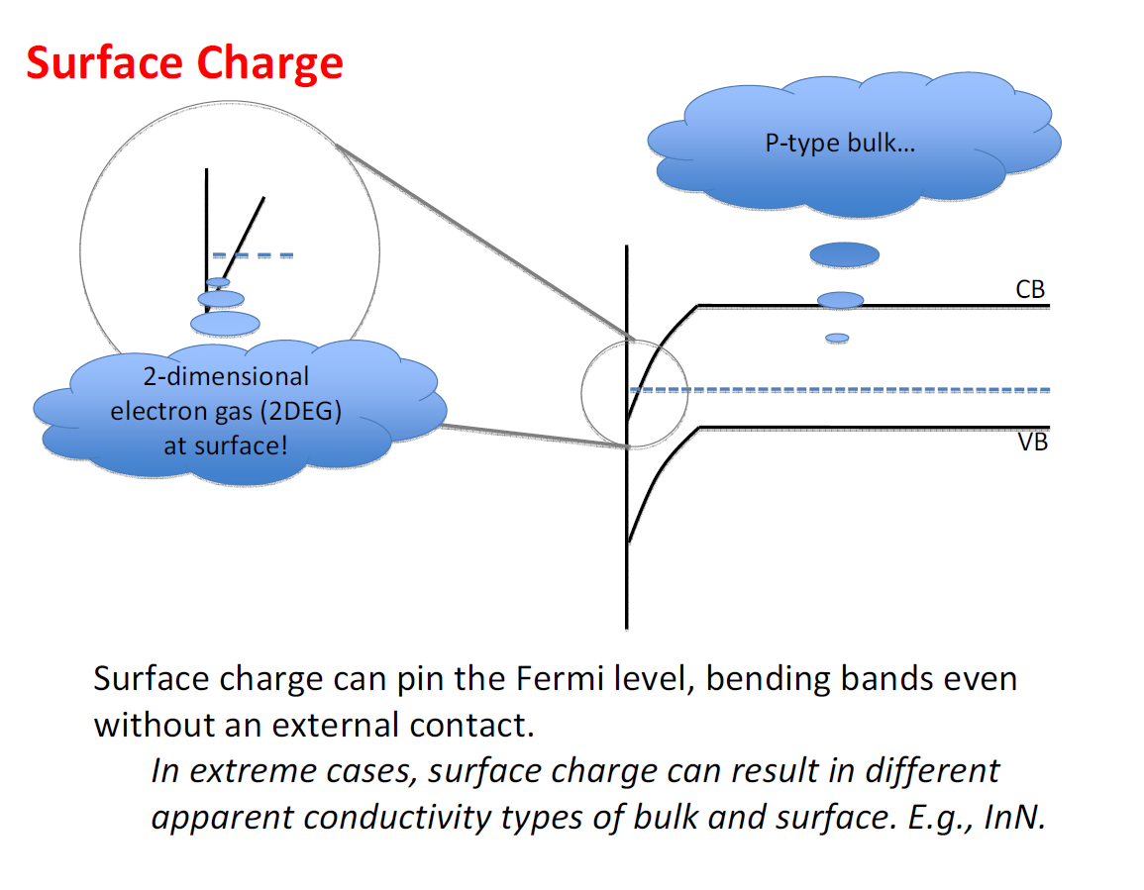
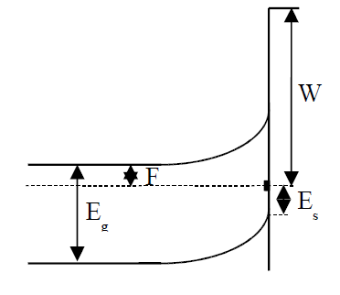

Slide 19
